Slide 1
SMART CLASSROOM AND TIMETABLE SCHEDULAR
Review-2
Batch Number:com_9
Under the Supervision of,
Mr. Laxman
Professor of practice
School of Computer Science and Engineering
Presidency University
Roll Number | Student Name
20221COM0017 | Nishanka M
20221COM0031 | Krishna Sai
20221COM0034 | Sunil Kumar Pandab
Name of the Program: Computer Engineering with specialization in Artificial Intelligence and Machine Learning
Name of the HoD: Dr. Gopal Krishna Shyam
Name of the Program Project Coordinator: Ms. Sumitha Guddin
Name of the School Project Coordinators: Dr. Sampath A K , Dr. Geetha A

Slide 2
CONTENT
Abstract
Literature Survey
Objectives
Existing Methods and Drawbacks
Proposed Method & Feasibility Study
Architecture Diagram
Modules
Hardware and Software Details
Timeline(Gantt Chart)
References

Slide 3
Abstract
University timetable scheduling is a complex NP-hard problem that involves allocating diverse courses, faculty, and classrooms while adhering to numerous overlapping constraints. Traditional manual methods are often inefficient, time-consuming, and prone to scheduling conflicts. This research proposes an AI-Optimized Automated Timetable Scheduler that integrates a hybrid methodology, combining the global search capabilities of Genetic Algorithms (GA) with the localized refinement of Spotted Hyena Optimization (SHO) and Simulated Annealing (SA). The system utilizes a modular Flask-Python backend and a React JS frontend to provide a user-friendly, scalable interface for conflict-free scheduling. Experimental results indicate that this hybrid approach significantly improves schedule quality by minimizing violations of "soft constraints," such as faculty preferences and room utilization. Ultimately, this system modernizes academic planning, reducing administrative workload and enhancing resource allocation efficiency.

Slide 4
LITERATURE SURVEY
1. Swarm Intelligence & Nature-Inspired Optimization
Van Du Nguyen & Tram Nguyen (2021) - "An SHO-based approach to timetable scheduling"
Objective: To improve the quality of high school and university timetables using social-behavioral algorithms.
Methodology: Spotted Hyena Optimizer (SHO) integrated with Simulated Annealing (SA). It uses a "swap sequence" to move from current schedules to better ones.
Findings/Drawbacks: Achieves high-quality results by mimicking social dependency. However, the execution time is higher compared to standard Particle Swarm Optimization (PSO).
Alireza Goli et al. (2019) - "Solving a University Exam Scheduling Problem"
Objective: Specifically targeting exam scheduling to minimize student fatigue and consecutive exams.
Methodology: Firefly Algorithm (FA) vs. Genetic Algorithm (GA).
Findings/Drawbacks: FA outperformed GA in finding "best fitness" (the most optimized schedule) but was significantly slower in computational processing.

Slide 5
LITERATURE SURVEY
2. Evolutionary & AI-Optimized Web Systems
Suraj Kumar Saw et al. (2025) - "Adaptive Scheduler: AI Optimization of Academic Timetable"
Objective: To create a dynamic, user-friendly academic scheduler for faculty and classrooms.
Methodology: A hybrid of Genetic Algorithms (GA) and Machine Learning for adaptive scheduling. Built using a Flask-Python backend.
Findings/Drawbacks: Excellent for generating conflict-free schedules and provides PDF exports. Limitation: It lacks a module for immediate "emergency" rescheduling when a faculty member is suddenly absent.
Anna Firer et al. (2025) - "Class Schedule WEB Application"
Objective: Automating university management through a client-server web interface.
Methodology: React JS for frontend and Python/Flask for backend, utilizing GA for automated management.
Findings/Drawbacks: Focuses on "Clean Architecture" for modularity. While stable, performance may lag as the number of student groups and specialized labs increases.

Slide 6
LITERATURE SURVEY
3. Constraint-Based & Automated College Tools
Prof. Wrushabh Shirsat et al. (2025) - "Automated Timetable Scheduler for Colleges"
Objective: To reduce manual effort in college planning and ensure 100% adherence to faculty availability.
Methodology: Rule-Based Constraint Satisfaction and automated generation logic.
Findings/Drawbacks: High ease of use for non-technical administrators. The drawback is its rigidity; it struggles with complex, cross-departmental shared resources.
M. K. Mohamed Faizal (2022) - "College Timetable using Time Scheduling Algorithm"
Objective: Managing department-wise schedules and automating alternative staff allocation.
Methodology: Data Category Algorithm combined with Artificial Neural Networks (ANN).
Findings/Drawbacks: Unique feature of allocating "alternative staff" automatically. However, ANN-based scheduling can be "opaque," making it difficult for admins to see why a certain slot was assigned.

Slide 7
Analysis of Problem Statement
The Problem: NP-Hard Complexity Timetabling is classified as an NP-Hard problem because the number of possible schedule combinations grows exponentially with every new teacher, room, or subject added. This "massive search space" means there is no simple formula to find the perfect solution; instead, the system must use advanced AI or heuristic algorithms to explore billions of possibilities to find an optimal one.
Manual Challenges & Hard Constraints Creating a schedule manually is labor-intensive and highly susceptible to human error, such as booking two classes in the same room simultaneously. Managing "Hard Constraints"—rules that are physically impossible to break (e.g., a teacher cannot be in two places at once)—becomes a logistical nightmare when done on paper or basic spreadsheets.
Goal: Balancing Automation and Satisfaction The primary objective is to automate the generation of a 100% conflict-free schedule that respects all hard constraints. Beyond basic logic, the system aims to optimize "Soft Constraints," which improve quality of life, such as minimizing long gaps between classes for students or honoring a faculty member's preferred teaching hours.

Slide 8
Existing methods and drawbacks:
Methodology | Algorithm(s) | Key Strengths | Specific Drawbacks
Evolutionary Computing | Genetic Algorithm (GA), NSGA-II | Efficiently searches massive datasets; excellent for global optimization. | Local Optima: Can get "stuck" in a good-but-not-perfect solution early on.
Swarm Intelligence | Spotted Hyena (SHO), Firefly (FA) | High precision; excels at finding the "best possible" fit for complex constraints. | High Latency: Significant computational time compared to simpler models.
Neural Models | Artificial Neural Networks (ANN) | Adaptive; learns from historical data and faculty leave patterns. | "Black Box" Logic: Hard for humans to understand or manually tweak the results.
Constraint Logic | Rule-Based, CSP | Straightforward implementation; great for simple, fixed schedules. | Lack of Scalability: Breaks down when facing cross-departmental dependencies.
Web-Based Tools | React / Flask Apps | High accessibility; user-friendly dashboards for staff and students. | Static Nature: Often focuses on data display rathe

Slide 9
Proposed Method & Feasibility Study
Phase I: Data Collection & Preprocessing
Structured Storage: Store faculty information, subject loads, and room capacities in a relational database (PostgreSQL) or JSON format.
Constraint Normalization: Preprocess data to identify "Hard" (non-negotiable) and "Soft" (desirable) constraints.
Phase II: The Hybrid Scheduling Engine
Step 1: Global Search (GA): Initialize a population of random timetables. Use selection, crossover, and mutation to evolve towards a conflict-free "chromosomal" representation.
Step 2: Local Repair (Simulated Annealing): To prevent the GA from stalling (Local Optima), apply Simulated Annealing (SA). SA "polishes" the best results by exploring neighboring solutions and accepting small "worse" moves temporarily to jump out of dead zones.
Step 3: Machine Learning Refinement: Use a supervised learning model (e.g., Random Forest) to evaluate historical "quality" scores and predict which room-slot pairs lead to the highest faculty satisfaction.
Phase III: Real-Time Adaptation Module
Dynamic Adjustment: Implement WebSockets for instant updates. If a faculty member marks an absence, the system triggers a "Local Repair" instead of a full regeneration, finding a substitute room or teacher without disrupting the rest of the schedule.

Slide 10
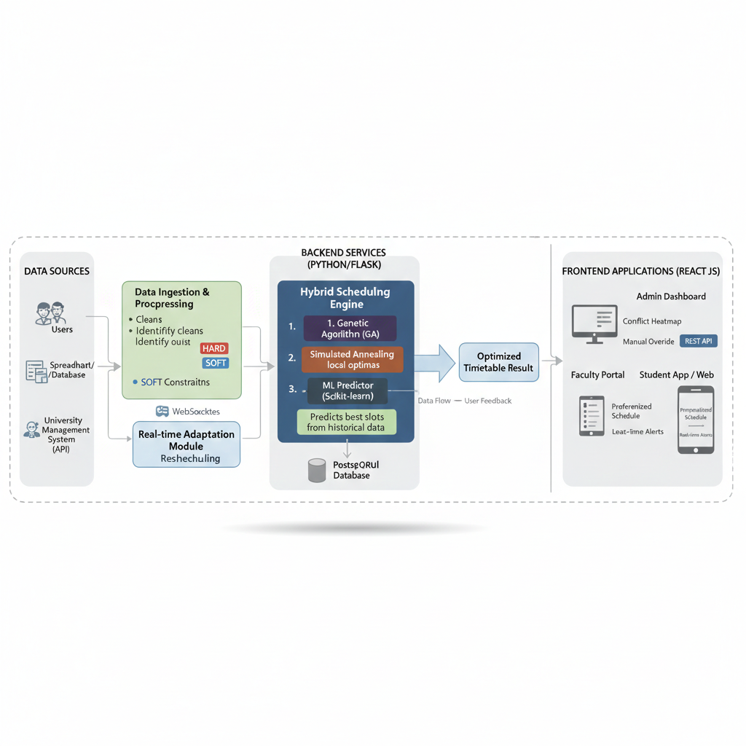
Architecture Diagram

Slide 11
Hardware and Software Details
Hardware: 8–12 GB VRAM GPU (e.g., RTX 3060), 32–64 GB RAM, ≥1 TB SSD; optional RTK UAV (DJI/Parrot).
Software: Python 3.10, PyTorch/TF, CUDA, GDAL/Rasterio, Albumentations, OpenDroneMap/WebODM or Agisoft, QGIS/ARC GIS; experiment tracking (MLflow/W&B).

Slide 12
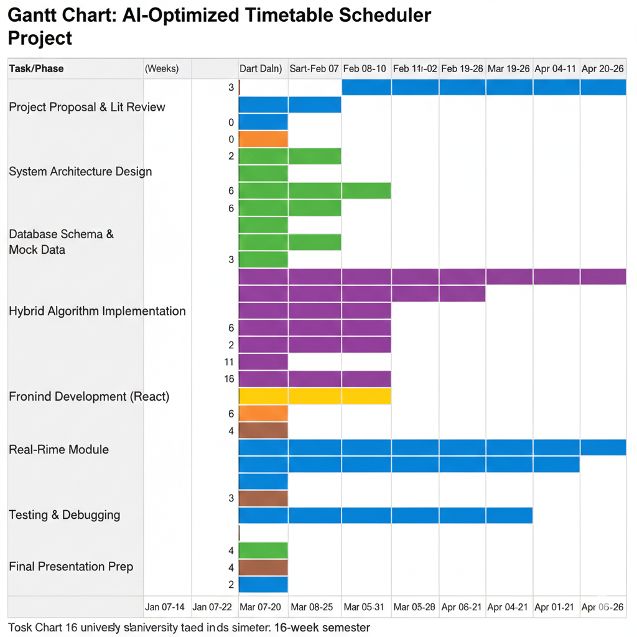
Timeline of the Project (Gantt Chart)

Slide 13
References (IEEE Paper format)
[1] Nguyen & Nguyen (2021) - "An SHO-based approach to timetable scheduling: a case study".
[2] Dhiman & Kumar (2018) - "Multi-objective spotted hyena optimizer".
[3] Goli et al. (2019) - "Solving a University Exam Scheduling Problem Using Genetic and Firefly Algorithms".
[4] Kumari Herath (2017) - "Genetic Algorithm For University Course Timetabling Problem".
[5] Shah et al. (2025) - "Optimizing Timetable Generation for Educational Institute Using Genetic Algorithm.
[6] Alonge et al. (2025) - "An Automated Timetable Scheduler Using NSGA II for Optimized Scheduling.
[7] Saw et al. (2025) - "Adaptive Scheduler: AI Optimization of Academic Timetable".
[8] Firer et al. (2025) - "Features of automation of university schedule management through Class Schedule WEB application".

Slide 14
References (IEEE Paper format)
[9] Shirsat et al. (2025) - "Automated Timetable Scheduler For Colleges: A Smart Solution".
[10] Mohamed Faizal (2022) - "College Timetable using Time Scheduling Algorithm"

Slide 15


